Slide 1







Data Science Capstone Project
Victor Santiago
09/04/2023

Slide 2



OUTLINE
Executive Summary
Introduction
Methodology
Results
Visualization – Charts
Dashboard
Discussion
Findings & Implications
Conclusion
Appendix

Slide 3

EXECUTIVE SUMMARY
SpaceX advertises Falcon 9 rocket launches on its website, with a cost of 62 million dollars.
Other providers cost upwards of 165 million dollars each, much of the savings is because SpaceX can reuse the first stage.
Therefore if we can determine whether the first stage will land, we can determine the cost of a launch.

Slide 4

INTRODUCTION
Four machine learning models were produced: Logistic Regression, Support Vector Machine, Decision Tree Classifier, and K Nearest Neighbors. All produced similar results with accuracy rate of about 83.33%. All models over successful predicted landings.
Information gathering can be used in an alternative company to bid against SpaceX for a rocket launch

Slide 5

METHODOLOGY
Data collection:
Combined data from SpaceX public API and SpaceX Wikipedia page
Perform data wrangling
Classifying true landings as successful and unsuccessful otherwise
Perform exploratory data analysis (EDA) using visualization and SQL
Perform interactive visual analytics using Folium and Plotly Dash
Perform predictive analysis using classification models
Tuned models using GridSearchCV

Slide 6
Data collection – SpaceX API:
Request and parse the SpaceX launch data using the GET request.
Filter the data frame to only include Falcon 9 launches.
Dealing with Missing Values.
Github:
https://github.com/victorvfrs/IBM/blob/main/jupyter-labs-spacex-data-collection-api.ipynb

Slide 7
Data collection – Web Scraping:
Request the Falcon9 Launch Wiki page from its URL.
Extract all column/variable names from the HTML table header
Create a data frame by parsing the launch HTML tables
Github:
https://github.com/victorvfrs/IBM/blob/main/jupyter-labs-webscraping.ipynb

Slide 8
EDA with SQL:
Queried using SQL Python integration.
Queries were made to get a better understanding of the dataset.
Queried information about launch site names, mission outcomes, various pay load sizes of customers and booster versions, and landing outcomes
Github:
https://github.com/victorvfrs/IBM/blob/main/jupyter-labs-eda-sql-coursera_sqllite.ipynb

Slide 9
EDA with Visualization:
Visualize the relationship between Flight Number and Launch Site
Visualize the relationship between Payload and Launch Site
Visualize the relationship between success rate of each orbit type
Visualize the relationship between Flight Number and Orbit type
Visualize the relationship between Payload and Orbit type
Visualize the launch success yearly trend
Create dummy variables to categorical columns
Cast all numeric columns to `float64`
Github:
https://github.com/victorvfrs/IBM/blob/main/IBM-DS0321EN-SkillsNetwork_labs_module_2_jupyter-labs-eda-dataviz.ipynb.jupyterlite.ipynb

Slide 10
Launch Sites Locations Analysis with Folium:
Mark all launch sites on a map.
Mark the success/failed launches for each site on the map
Calculate the distances between a launch site to its proximities
Github:
https://github.com/victorvfrs/IBM/blob/main/IBM-DS0321EN-SkillsNetwork_labs_module_3_lab_jupyter_launch_site_location.jupyterlite.ipynb

Slide 11
Interactive Visual Analytics and Dashboard:
Add a dropdown list to enable Launch Site selection.
Add a pie chart to show the total successful launches count for all sites
Add a slider to select payload range
Add a scatter chart to show the correlation between payload and launch success
Github:
https://github.com/victorvfrs/IBM/blob/main/Interactive%20Visual%20Analytics%20and%20Dashboard

Slide 12
Machine Learning Prediction:
Create a NumPy array from the column Class in data, by applying the method to_numpy() then assign it to the variable Y,make sure the output is a Pandas series (only one bracket df['name of column']).
Standardize the data in X then reassign it to the variable X using the transform provided below.
Use the function train_test_split to split the data X and Y into training and test data. Set the parameter test_size to 0.2 and random_state to 2. The training data and test data should be assigned to the following labels.

Slide 13
Machine Learning Prediction:
Create a logistic regression object then create a GridSearchCV object logreg_cv with cv = 10. Fit the object to find the best parameters from the dictionary parameters.
Calculate the accuracy on the test data using the method score:

Slide 14
Machine Learning Prediction:
Create a support vector machine object then create a GridSearchCV object svm_cv with cv - 10. Fit the object to find the best parameters from the dictionary parameters.
Calculate the accuracy on the test data using the method score:

Slide 15
Machine Learning Prediction:
Create a decision tree classifier object then create a GridSearchCV object tree_cv with cv = 10. Fit the object to find the best parameters from the dictionary parameters.
Calculate the accuracy of tree_cv on the test data using the method score:

Slide 16
Machine Learning Prediction:
Create a k nearest neighbors object then create a GridSearchCV object knn_cv with cv = 10. Fit the object to find the best parameters from the dictionary parameters.
Calculate the accuracy of knn_cv on the test data using the method score:

Slide 17
Machine Learning Prediction:
Find the method performs best.

Slide 18
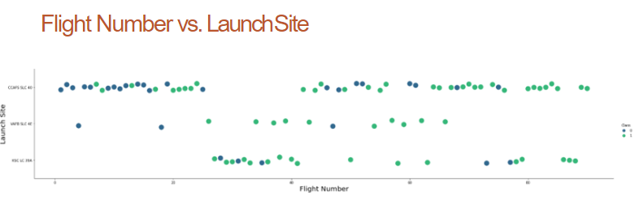
RESULTS
Green indicates successful launch and purple indicates unsuccessful launch

Slide 19
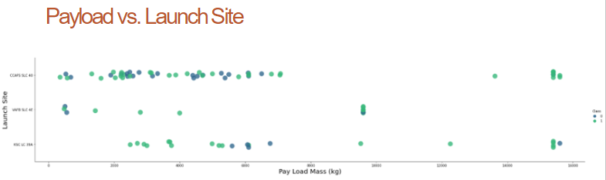
RESULTS
Green indicates successful launch and purple indicates unsuccessful launch

Slide 20
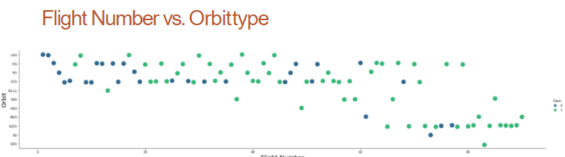
RESULTS
Green indicates successful launch and purple indicates unsuccessful launch

Slide 21
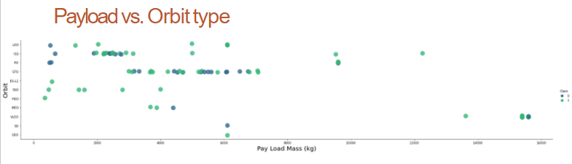
RESULTS
Green indicates successful launch and purple indicates unsuccessful launch

Slide 22
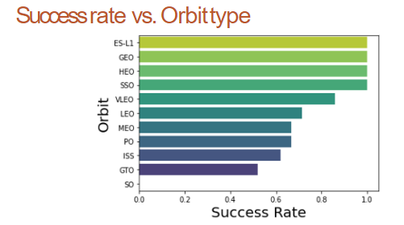
RESULTS
Success Rate Scale with 0 as 0%
0.6 as 60% 1 as 100%

Slide 23
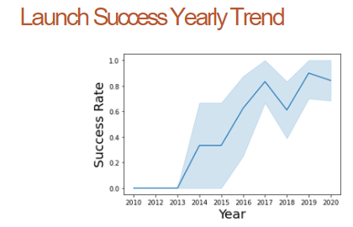
RESULTS
95% confidence interval (light blue shading)

Slide 24

DISCUSSION
After that, do you still have doubts about the energy future of the world being out of Earth orbit and the investment in rockets that return to base is the beginning of the foundation of this achievement?

Slide 25

CONCLUSION
Our task is to develop a machine learning model for Space Y who wants to bid against SpaceX
The goal of model is to predict when Stage 1 will successfully land to save ~$100 million USD
Used data from a public SpaceX API and web scraping SpaceX Wikipedia page
Created data labels and stored data into a SQL database
Created a dashboard for visualization
We created a machine learning model with an accuracy of 83%
If possible more data should be collected to better determine the best machine learning model and improve accuracy

Slide 26

APPENDIX
GitHub repository:
https://github.com/victorvfrs/IBM

